Slide 1
Chunming Xie
（谢春明）
Department of Neurology,
Zhongda Hospital affiliated to Southeast University
Nanjing, China
Notes:
Today we will start a new course, Neurology. This is our textbook, essential neurology.

Slide 2
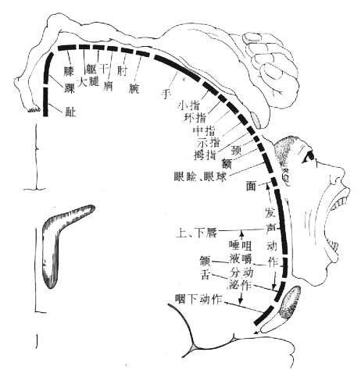
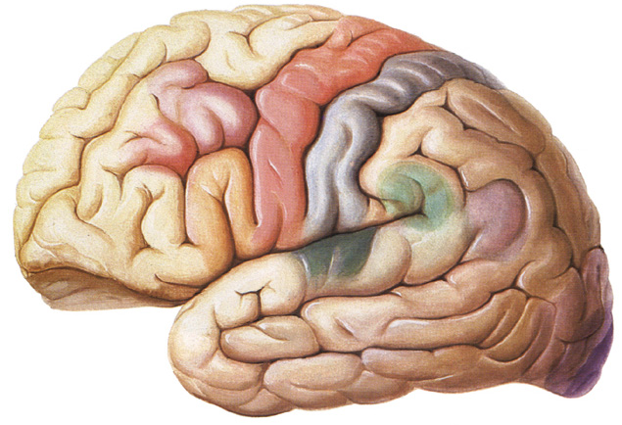
Features of various part lesion
Leg monoplegia
Motor cortex
  Monoplegia: as motor cortex is spread over a large area, cortical lesion usually gives rise to monoplegia rather than hemiplegia
Contralateral monoparalysis

Slide 3
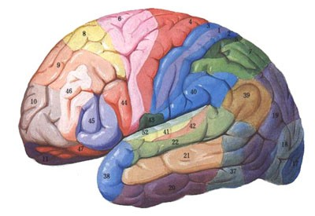
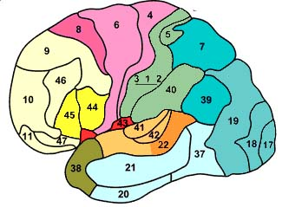
Features of various part lesion
Cerebral Cortex
  Aphasia or dysphasia: if the lesion is in the frontal lobe, esp in inferior frontal gyrus, aphasia is present.
  Grasp reflex is present and the patient is emotionally labile(unstable).
  Other manifestations like apraxia or agnosia may be present.
  Specific manifestations due to lesions of various lobes such as
    inferior quadrantanopia
    homonymous hemianopia

Slide 4
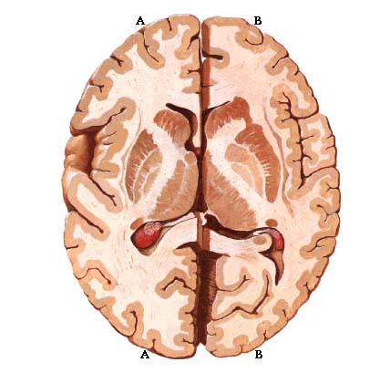
Features of various part lesion
Internal capsule
  uncrossed hemiplegia: such as left hemiplegia plus left facial palsy.
  hemisensory loss
  homonymous hemianopia
Notes:
As the motor fibers, sensory fibers and optic fibers are very closely packed in the internal capsule, its lesion give rise to dense hemiplegia, facial palsy and homonymous hemianopia. This is syndrome of internal capsule.

Slide 5
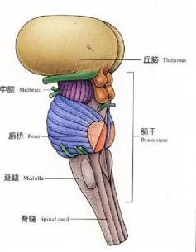
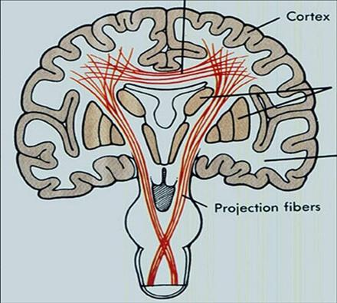
Features of various part lesion
Brain stem
  Crossed hemiplegia: cranial nerve palsy is on one side and hemiplegia is on the other side.
    Motor cranial nuclei control the ipsilateral cranial muscles, for example, left facial nerve controls left facial muscles.
    While the pyramidal tract in unilateral brainstem crossed through pyramid in medulla oblongata to opposite side of spinal cord.
    Lesion is on the side of cranial nerve palsy.

Slide 6
Features of various part lesion
Brain stem
  Further localization depends on cranial nerve involvement lesion.
    3rd nerve ——midbrain
    7th nerve——pons
    9th,10th or 12th nerve——
    medulla oblongata
Notes:
Brainstem consist of midbrain, pons and medulla. Further localize the lesion

Slide 7

Features of various part lesion
Spinal cord
  If spinal lesion is unilateral, the lesion is on the side of motor weakness.
  Hemisection of spinal cord (Brown-Sequard syndrome): below the level of the lesion there is:
    ipsilateral UMN weakness and loss of sense of position
    contralateral loss of sense of pain and temperature
  UMNL is usually bilateral. A transverse spinal lesion causes quadriplegia or paraplegia.
Complete
transection
Hemisection
Brown-Sequard
B-S-S
Paraplegia

Slide 8
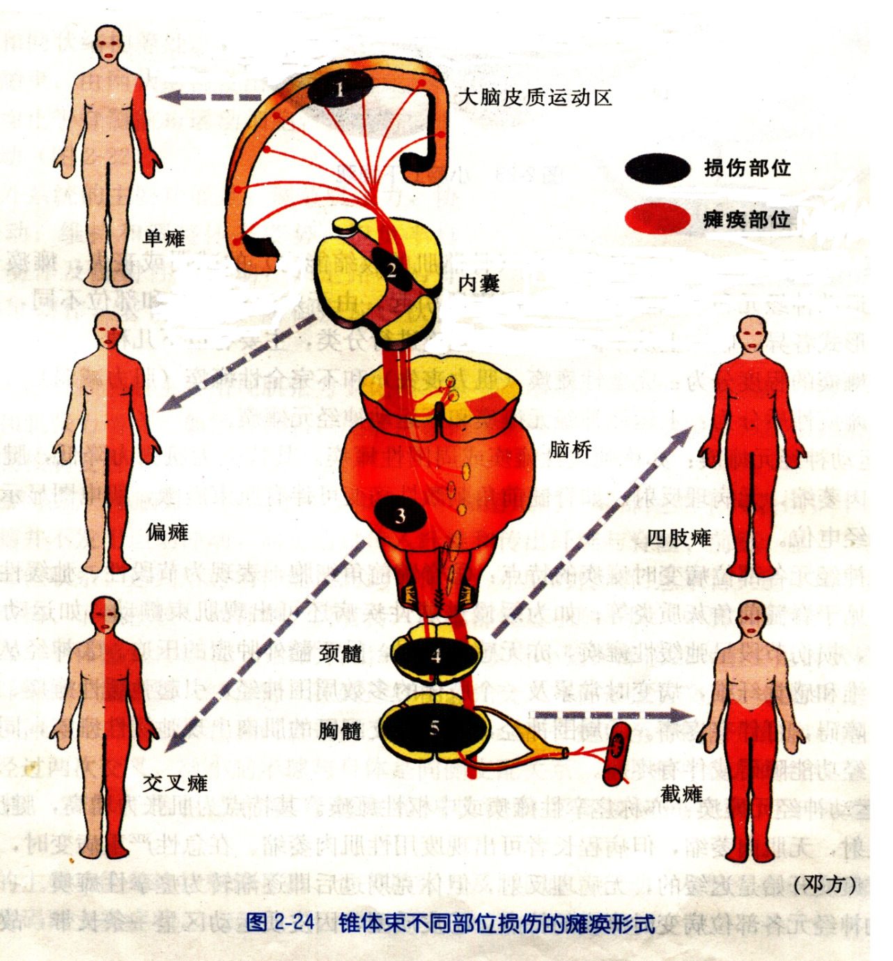
monoplegia
hemiplegia
quadriplegia
Crossed hemiplegia
paraplegia
Paralysis subtypes of lesion in pyramidal tract

Slide 9
Features of LMN lesion
Nuclei of cranial nerves: the damage of the motor nuclei of the brainstem.
  If nuclei of cranial nerves are involved, there is paralysis of muscles supplied by the affected nerves.
  Manifestations are similar if cranial nerves themselves are involved along their course.
  Incomplete damage of oculomotor nerve is a special feature, because oculomotor nucleus is scattered and spread in the brainstem.

Slide 10
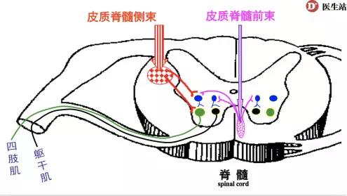
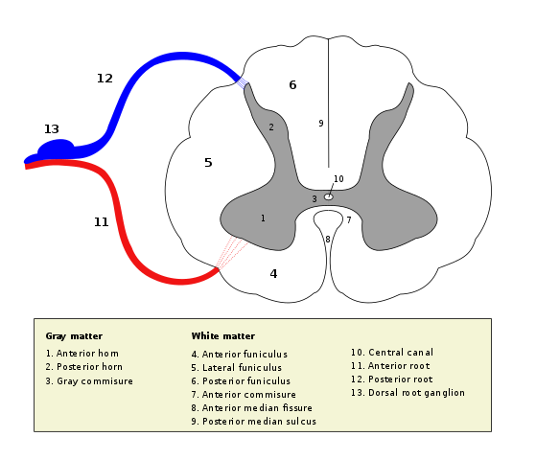
Features of LMN lesion
Anterior horn cells:
  Poliomyelitis: seen in childhood
  Motor neuron disease: manifestations are widespread, such as paraparesis or quadriparesis with twitching.
Nerve root:
  If a root is involved, the muscles supplied by that root are paralyzed.
  For example, if C7 or C8 root is damaged, there is paralysis of the small muscles of the hand.

Slide 11
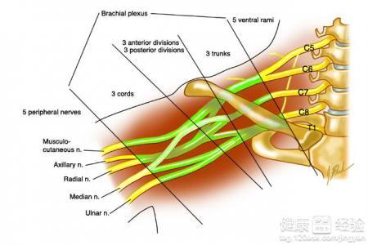
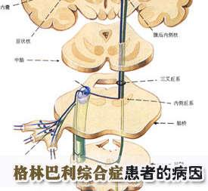
Features of LMN lesion
Peripheral nerves
  If peripheral nerves are involved, muscles of distal parts of the limbs are affected.
  In Guillain-Barre syndrome, there is quadriplegia.

Slide 12
Cerebellar dysfunction
Signs: ataxia, hypotonia, nystagmus, dysarthria
Ataxia refers to impaired coordination.
  Cerebellar hemisphere lesion affects the limbs on the same side.
    finger-to-nose test
    heel-knee-shin test
  With midline lesion of cerebellum, there is marked trunk ataxia, especially on walking.
    Romberg test
Notes:
If the cerebellum is damaged, there are several signs. Such as ataxia, hypotonia, nystagmus,and dysarthria, esp. ataxia.
Touch the tip of nose by his index finger.

Slide 13
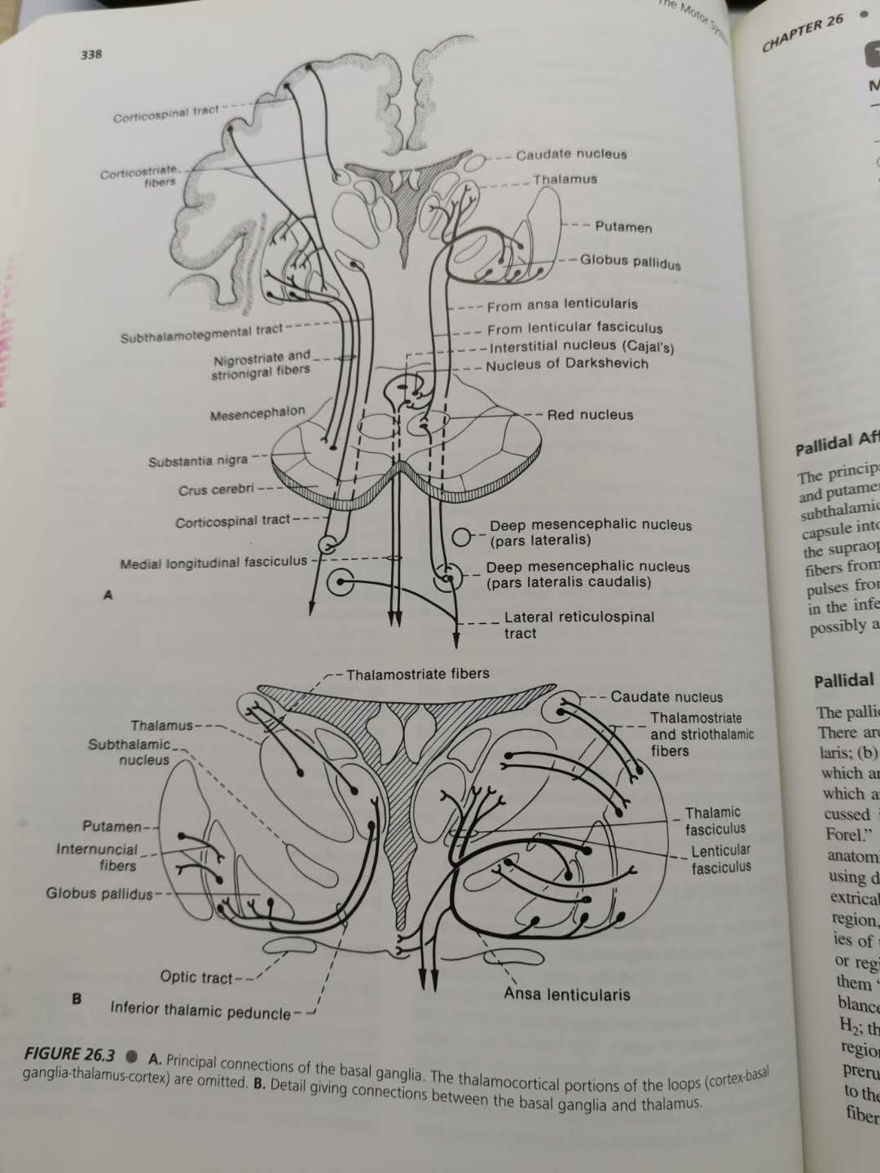
Extrapyramidal disorder
Abnormalities are mainly as follows:
  Tremor: It is a steady rhythmic oscillatory movement of the muscles.
  Chorea: rapid, irregular, jerky movements
  Dystonia: It refers to involuntary and prolonged muscular contraction that give rise to repetitive twisting or abnormal postures.
  Myoclonus: sudden rapid twitch like muscle contraction

Slide 14
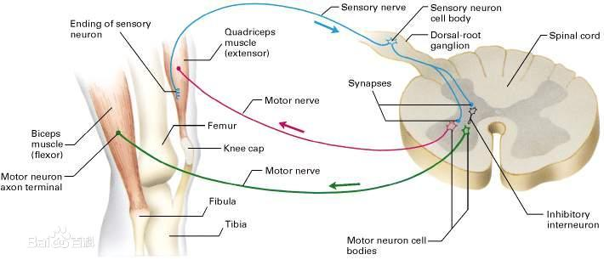
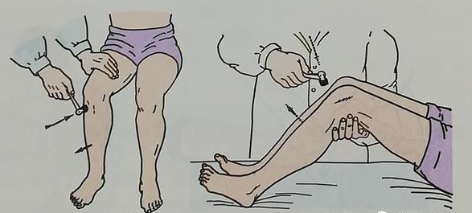
Reflex
The basis of reaction is reflex arc, which consists of a receptor, afferent fiber, spinal center, efferent fiber and effector organ.
Whole reflex arc should be intact for the reflex to be elicited.
Notes:
We know that reflex is the basic activity in biological phenomena.

Slide 15
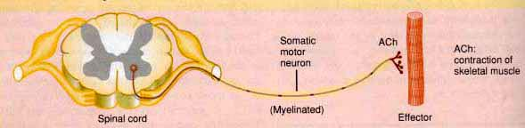
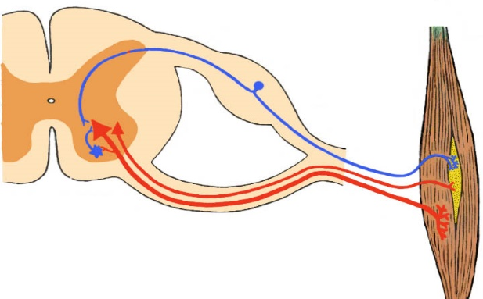
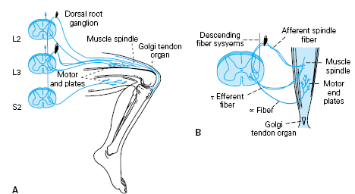
Physiological Reflex
Tendon reflexes (deep reflexes or tendon jerks)
  Common tendon reflexes
    biceps jerk(C5-6), triceps jerk(C6-7), brachioradialis jerk(C5-6)
    knee jerk(L2-4), ankle jerk(S1-2)
  Tendon reflexes may be normal, increased or diminished.
    Increased tendon jerks (hyperreflexia): they are the sign of upper motor neuron lesion (UMNL), especially it is present in one limb or one half of the body.
    Diminished tendon jerks (areflexia): reflexes are diminished or absent in lower motor neuron lesion (LMNL).
-motor
neuron
- motor
neuron
Muscle
spindle
Striate
muscle

Slide 16
Physiological Reflex
Pathological signs
Superficial reflexes
  Common superficial reflexes
    corneal reflex, abdominal reflex(T8-12), cremasteric reflex(L1-2), anal reflex(S3-4)
  Superficial reflex loss occurs with UMNL and LMNL.
Pathological signs:
  Babinski sign is an abnormal reflex. It indicates the lesion of UMN including motor cortex and corticospinal tract.
  Others:
    Chaddock sign
    Oppenheim sign
    Gordon sign

Slide 17
Sensory System
  1 Anatomy and Physiology
  2 Sensory symptoms
  3 Localization of lesion

Slide 18
1 Anatomy and physiology
Primary sensations: They are pain, temperature, touch, vibration, joint position sense. Primary sensations are divided into 2 types based on sensory receptor:
  Superficial senses: sensory receptors in skin and mediating superficial sensation, including pain and temperature and portion of touch
  Deep senses: joint position sense, sense of passive movement, and vibration
Cortical sensations:
  Sense of localization,
  Two point discrimination,
  Stereognosis,
  Graphesthesia.

Slide 19
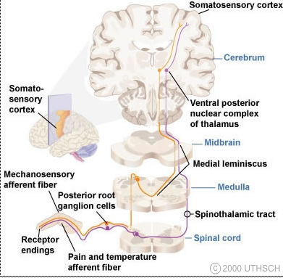
1 Anatomy and physiology
Sensory stimuli are perceived by sensory receptors and transmitted to the dorsal root ganglions through peripheral sensory nerves.
Central axons of dorsal root ganglions enter the spinal cord where fibers are divided into two groups.
  Dorsal Column
  Lateral Spinothalamic Tract

Slide 20
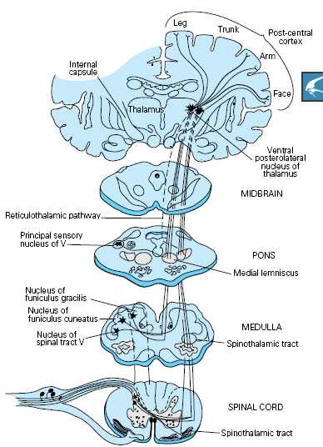
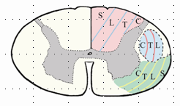
Dorsal Column
Deep sensory pathways
  fibers concerned with deep sensation enter the posterior part of the spinal cord, namely dorsal column, and ascend upwards on the same side.
  They relay in the gracile and cuneate nuclei.
  The fibers from those 2 nuclei cross to the opposite side and pass upwards to thalamus and at last to sensory cortex.
  dorsal root ganglion——dorsal column——gracile, cuneate nuclei——sensory decussation——thalamus——sensory cortex
Deep sensation
  position
  Vibration
  passive movement
  touch

Slide 21
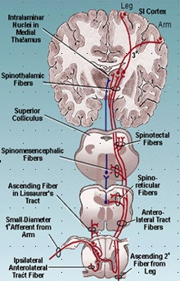
Lateral Spinothalamic Tract
Superficial sensation
  Pain
  Temperature
Superficial sensory pathways
  dorsal root ganglion——dorsal horn——crossing to lateral spinothalamic tract——thalamus——sensory cortex
  In the brainstem, the spinothalamic fibers are joined by the fibers of the trigeminal nerve.

Slide 22
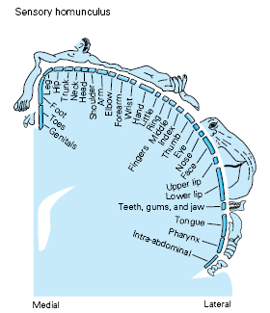
Sensory Cortex
Sensory cortex occupies the post central gyrus.
Just like motor cortex, sensory cortex is a deformed homunculus.

Slide 23
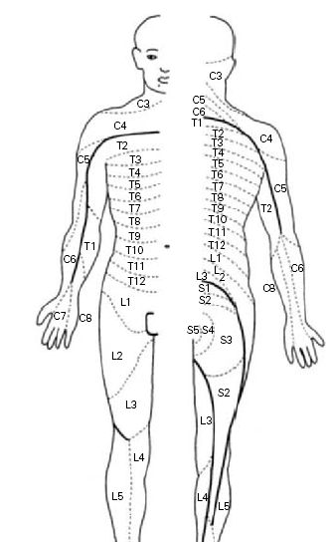
Dermatomes and cutaneous nerves
C2, C3 | occipital and neck
C4 | shoulder
C5—T2 | arm
T4 | breast
T6 | xiphoid
T10 | umbilicus
T12 | inguen
L1—S2 | leg
S1, S2 | foot
S3—S5 | perianal region
Notes:
P134 Fig9-4

Slide 24
Sensory Symptoms
Positive phenomena: abnormal sensations such as
  tingling
  pins-and needles
  pricking
  burning
  electric current like sensations or pain
Negative phenomena
  does not appreciate normal sensations like touch, pain or temperature.

Slide 25
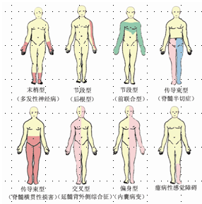
Localization of lesion various kinds of sensory loss are associated with the localization of lesion
sensory root
spinal cord
spinal cord
peripheral nerves
spinal cord
brain
stem
internal capsule
hysteria

Slide 26


Peripheral nerves
Sensory root
If there is peripheral neuropathy, the sensory loss is over the distal parts of limbs-in glove and stocking distribution.
Sensory loss is in the distribution of the affected nerve root.

Slide 27

Spinal cord
When spinal cord is injured, bilateral spinothalamic tracts and dorsal columns are involved
So, there is loss of all senses below the level of the lesion:
  pain
  temperature
  vibration
  joint position
  touch

Slide 28

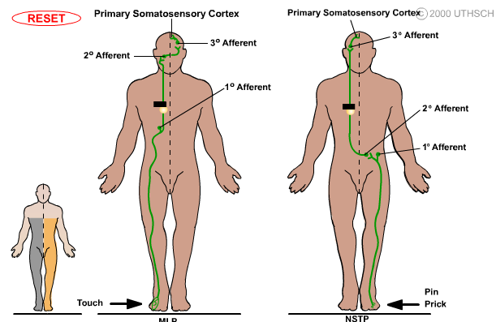
Spinal cord
When unilateral spinothalamic tract is involved, there is loss of pain and temperature below the level of the lesion on the opposite side of the body.
If one side of posterior column is involved, there is loss of sense of position and vibration below the level of the lesion on the same side.

Slide 29

Spinal cord
Dissociated anesthesia: some modalities are affected while others are intact. Usually pain and temperature are lost, and touch, position and vibration are intact.
This occurs in syringomyelia.

Slide 30

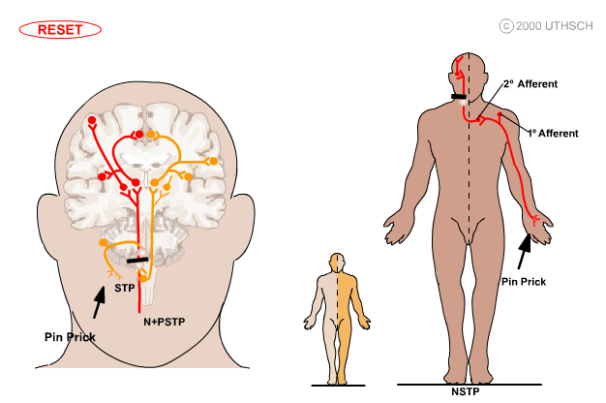
Brain stem
Crossed anesthesia:
the loss of pain and temperature on the same side of the face and the opposite side of the body.

Slide 31
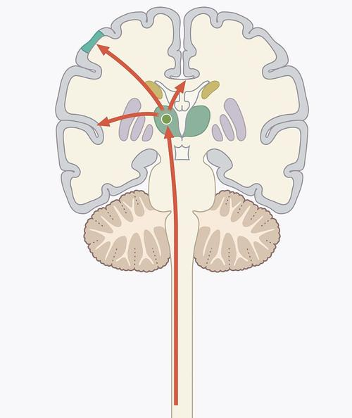
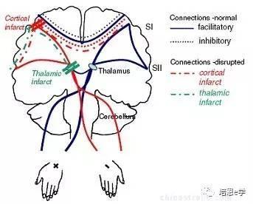
Thalamus
In lesion of the thalamus
  Contralateral touch is lost
  Unpleasant pain on the contralateral side
  Threshold of the pain is increased, but it is severe when it occurs.

Slide 32

Internal capsule
Hemianesthesia:
  such as sense loss of left face, left arm and left leg
Accompanied by
  hemiplegia
  homonymous hemianopia

Slide 33

Sensory cortex
Lose of cortical sensations
  localization
  two point discrimination
  stereognosis
  Graphesthesia
Touch, pain and temperature are intact.
monoplegia is common.

Slide 34
Questions:
Difference of the UMN and LMN?
The definition of dissociated anesthesia.
Describe the features of damaged motor system and sensory system briefly.

