Slide 1
Welcome to
Medical Statistics
医学统计学
Yu xiaojin 余小金
Phd , Associate professor from
Department of Epidemiology & Biostatistics ,public Health school
xiaojinyu@seu.edu.cn

Slide 2
Syllabus(2013)
11 lectures, W3-14,Tuesday3-5,
computer Lab.W10-20, Tuesday6-8,central computer lab(Floor4)
Assessment: 60% from quiz, homework and final exam; 40% from computer lab.

Slide 3
Syllabus(2011)
11 lectures, W3-14,Friday1-3,
computer Lab.W10-20, Wedn.6-8,public Health build, Room604
Assessment: 60% from quiz, homework and final exam; 40% from computer lab.

Slide 4
Contents
Introduction to medical statistics-relevant terms
Statistical description(1)
Statistical description(2)-graph and table

Slide 5
E-books
Introductory biostatistics http://www.hstathome.com/tjziyuan/Introductory%20Biostatistics%20Le%20C.T.%20%20(Wiley,%202003)(T)(551s).pdf
Introductory biostatistics for the health science
http://faculty.ksu.edu.sa/hisham/Documents/eBooks/Introductory_Biostatistics_for_the_Health.pdf

Slide 6
Lecture 1
Introduction To Medical Statistics

Slide 7
An Overview of Statistics
What does mean by Statistics/Medical Statistics?
Why do medical students need statistics?
What will be learn in medical statistics?

Slide 8

A study by Logitech revealed that nearly
50 percent chance that your lost remote control is stuck between your sofa cushions;
4 percent of lost remotes are found in the fridge or freezer;
2 percent turn up somewhere outdoors or in the car.
Where is my remote control ?

Slide 9

Is fishing dangerous?
Fishing may seem like a relaxing pastime so low-key, in fact, that some find it infernally dull but it's actually the most dangerous occupation in the United States, according to the U.S. Bureau of Labor Statistics.
In 2008, the fatal injury rate for fishers and related fishing workers was 128.9 deaths per 100,000. That's much higher than the fatal injury rate for truck drivers, roofers, electrical power-line installers and repairers, and even miners, all of whom had death rates below 35 per 100,000 workers in 2008.

Slide 10
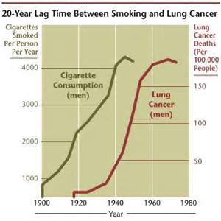
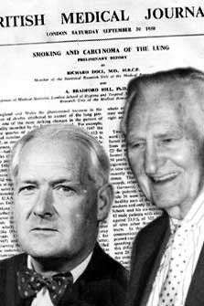
Smoking is hazard to your health

Slide 11
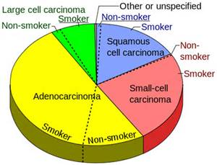
What do you learn?

Slide 12
Almost Everyday We Are Exposed to Statistics
The probability to rain is 0.6 tomorrow
More than 65% people in China believe that---
The population of china is over 1’200’000’000. (1.2billion)
……

Slide 13


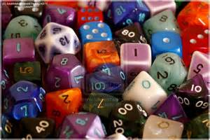
statistics
Life
Medical Career

Slide 14
Definition of Statistics
the science or art of collecting, organizing, analyzing, & interpreting data in order to make decisions.
The Basic-Facts or figures
Notes:
Most students have enrolled in statistics because it is required. Most have no idea of what statistics is about.
In Chapter 1 you’ll learn about different types of data (pieces of information) and methods of collecting data.

Slide 15
Biostatistics
Statistics applied to biological (life science) problems, biometry, including:
  Public health
  Ecological and environmental
  Medicine
Much more statistics than biology, however biostatisticians must learn the biology also.

Slide 16
Medical Statistics
When the data are derived from medicine.
To inference Relationship between disease and risk factors
Assessment of effect of drug, and other treatments,

Slide 17
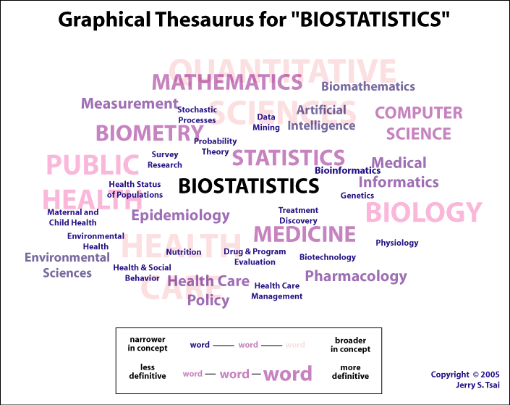
  biostatistics.

Slide 18
Why Do medical students Need Medical Statistics?
Summarizing the experience of Medicine and making prediction about some medical hypotheses.
Uncertainty existing in organism-animals and human being.

Slide 19
Table 1 Results Of An Animal Experiment supposed
Treatment | Die | Survive | Total
Drug | 0 | 50 | 50
No drug | 50 | 0 | 50
Total | 50 | 50 | 100
Half of rats infected by disease organism are given a dose of drug, and half placebo
How can one be objective and make decision in the face of uncertainty?

Slide 20
Medicine Journals
Almost every research result needs to be presented by numerical summary and statistics tests.
As a medical worker, you need techniques to read and understand the articles in Medicine Journals.

Slide 21
The 3rd question
What will we learn from medical statistics?

Slide 22
After Studying Medical Statistics, You Will Be Able to
Understand basic procedure of medical research like an experiment, clinical trial, survey
BASIC STATISTICAL TECHNIQUE
  Summarize-tables & graphs
  Analyzing-classify, comparing & correlated
  Interpreting-how and why?
  Presenting - papers published on medical Journals
Thinking in Statistics

Slide 23
As A Common Citizen
Statistical thinking will one day be as necessary for efficient citizenship as the ability to read and write.
H.G.Wells

Slide 24

2 Branches of Statistics
Descriptive Statistics
Involves organizing, summarizing, and displaying data.
Inferential Statistics
Involves using sample data to draw conclusions about a population.
Notes:
Descriptive statistics involve graphs creating numerical summaries. Techniques of descriptive statistics will be covered in the next chapter. Inferential statistics will be introduced in later chapters.

Slide 25
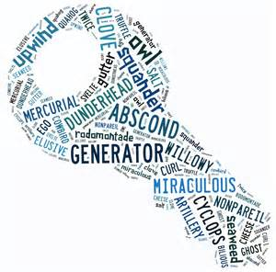
1.2 key words in Statistics
Population(individual) & sample
Variation & random variable
types of data
Statistic & parameter
Sampling error
Probability

Slide 26
Population & Sample
The entire group or the measurements of the entire group that researchers are of interest.
A portion or subset of the population that we use for inferring population.
Sample Size n
The number of individuals to be included in a sample.
Individual: An unit in population
Notes:
To learn about any subject, it is important that you know the language of that subject. Here are some commonly used terms. Although a group of people working for a specific computer software company is shown, the population actually consists of the data set. Each piece of data is represented by an x. The population could be the type of car they each drive, their seniority rank, the year they were born or their gross income in 2002.
How do you know if a data set is a population or a sample? This depends on the context of the problem. If you are doing a study that only concerns workers of this company then use the people in the company to produce the population of values. On the other hand, if your study involves all workers in computer software companies in California, then you would use all the people at the top as a sample (called a cluster sample) of the population. Each population has many many possible samples.
Population of values may not come from people at all. If you are interested in the miles per gallon of all Honda Civics then the population would be measured from the cars.

Slide 27
Why sampling?
you don’t have to drink out the whole pot of soup before you know It is delicious or not?

Slide 28
Characteristic of Population
Usually the population is too big or difficult to be observed or measured completely.
The heights of all of the boys of aged 7.
100 heights of 100 boys of aged 7.

Slide 29

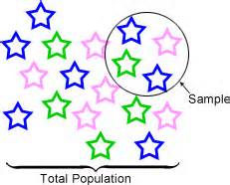
Random Sample
The individuals in the population have the same chance to be drawn as one of the sample
The individuals are drawn independently.

Slide 30
The bigger the samples, the more representative to population

Slide 31
An Example
A new drug for hypertensions
  Individual?
  Population? infinite or finite?
  Sample?
  Result?
  Conclusion?

Slide 32
Variation & Random variable
Certain characteristics of the population are of particular interest( systolic/diastolic blood pressure, weight, resting body temperature). The value of these characteristics will vary from individual to individual with the population.
These characteristics are called random variable or variable;
The varying between individuals are called variation.

Slide 33
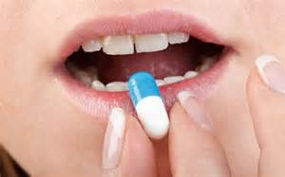
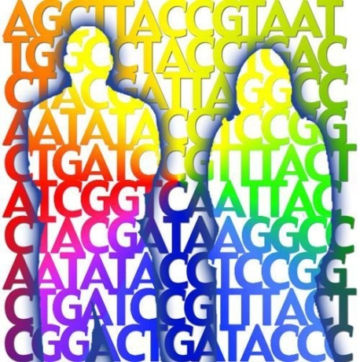
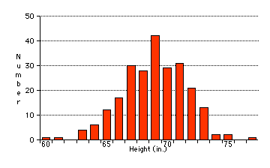

Variation in Medicine
Humans differ in response to treatment
Humans differ in disease symptoms
Diagnosis and treatment is often probabilistically based

Slide 34
Properties of Variation
  A property that individuals are different. (dissimilar)
  Cause by incontrollable factors (known or unknown)
  random (cannot predict exactly)
  ubiquitous(普遍存在的)
  Individual variation has it’s own distribution.
No individual variation, No statistics!

Slide 35

individual variation

Slide 36

Data-Values of Variable
Variables are characteristics of observation, for example , height, weight, sex and so on
Data are values of variables that are obtained by observing or measuring
Data consist of information coming from observations, counts, measurements, or responses.

Slide 37
Type OF DATA
TYPE OF DATA | EXAMPLE
quantitative data | height,weight
ranked (ordinal) data | Medical test outcome, scores of ache; scores of ache
qualitative data | sex, type of blood,marital status

Slide 38
Data Table
No | Profession | Age (year) | Gender | Height (cm) | Blood types | Cardiogram | WBC in urine | RBC 10¹²/L
1 | Teacher | 35 | F | 1.65 | A | Normal | － | 4.67
2 | worker | 44 | M | 1.74 | B | Normal | － | 5.21
3 | clerk | 26 | F | 1.80 | O | Normal | + | 4.10
4 | Farmer | 25 | F | 1.61 | AB | Normal | + | 3.92
5 | worker | 41 | M | 1.71 | A | Abnormal | ++ | 3.49
6 | worker | 45 | F | 1.58 | B | Normal | ++ | 5.48
7 | farmer | 50 | F | 1.60 | O | Abnormal | ++ | 6.78
8 | clerk | 28 | M | 1.76 | AB | Abnormal | +++ | 7.10
9 | armyman | 31 | F | 1.62 | O | Mormal | ＋ | 5.24

Slide 39
Another Classification
numerical variable
categorical variable
binary variable/ dichotomous
polytomous variable
multinomial
Ordinal (or ranked data)

Slide 40
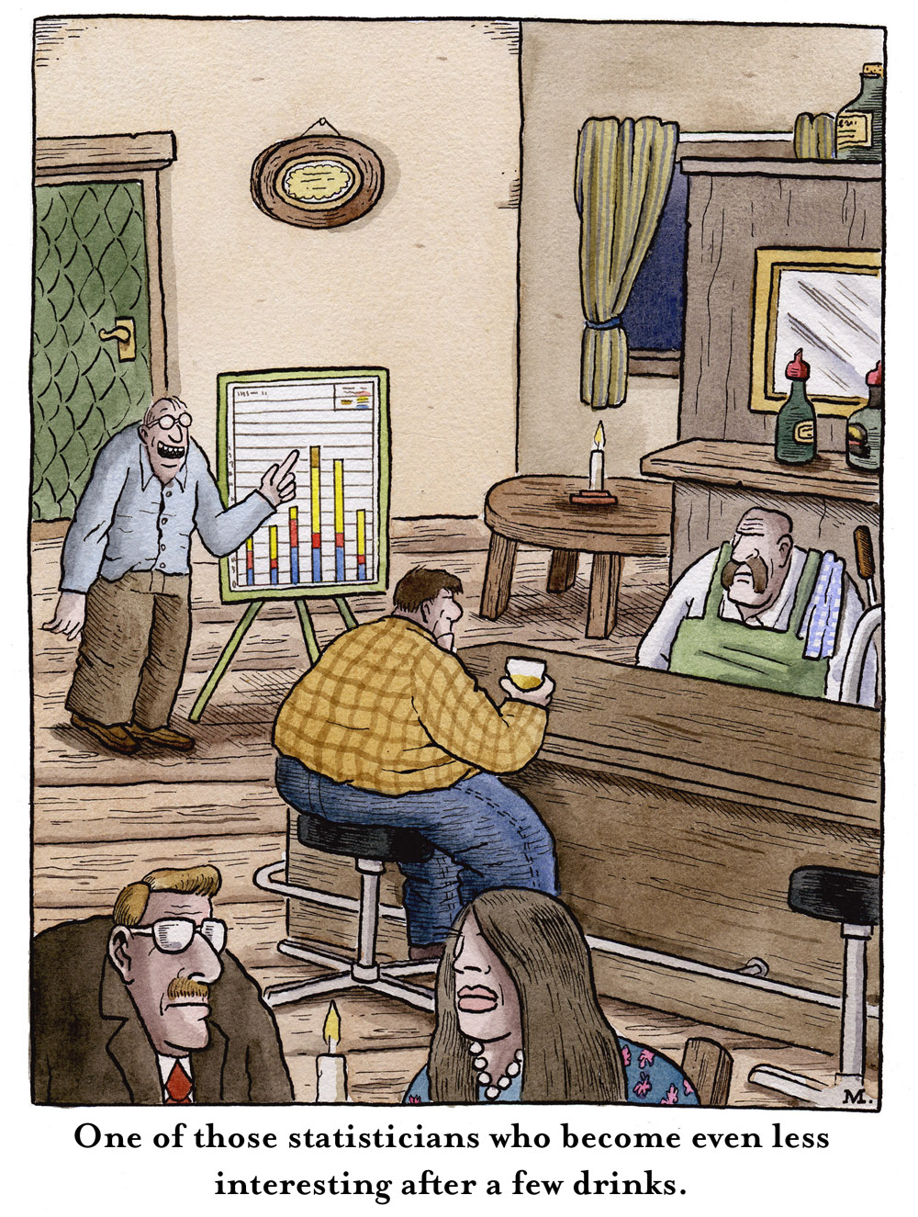
In God we trust.
All others must bring data.
Statisticians are figure oriented rather than people oriented.

Slide 41

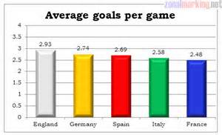
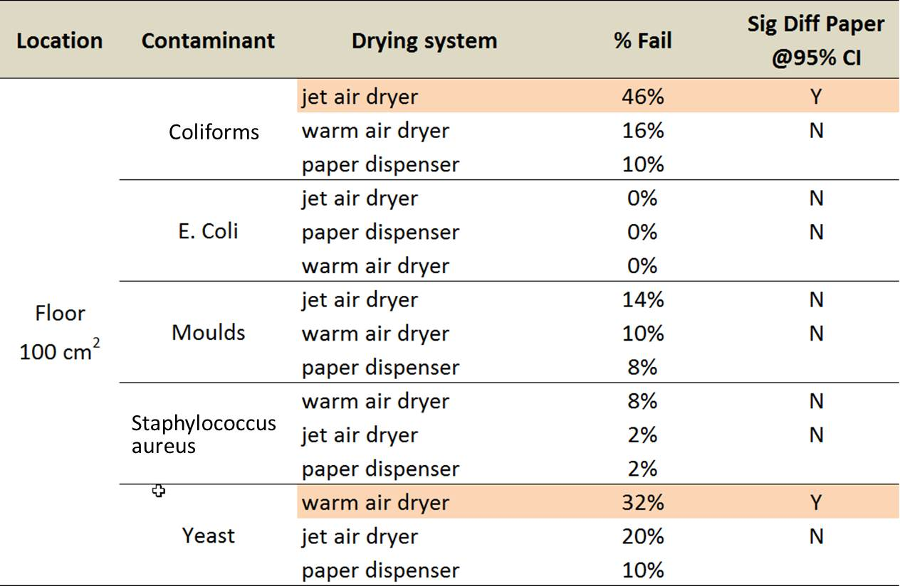
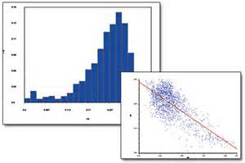
What will we do when we get data?

Slide 42
Parameter
A number that describes a population characteristic.
Average gross income of all
people in China in 2002.
Statistic
A number that describes a sample characteristic.
Average Gross income of people from a sample of 3 provinces in 2002.
Notes:
These terms are used throughout the course. The arrows at the end, emphasize the connection between population parameter and sample statistic. You will also later learn that this type of sample is called a cluster sample because it comes from intact units in the population.

Slide 43
Parameter & Statistic
population parameter
  unknown, inherent, constant, interested！
  Represented by Greek letters (μ = mean)
sample statistic
  Known, changeable, with sampling error
  Represented by Latin letters (X = mean)
Different descriptive for different type of data.

Slide 44
Sampling Error
Difference between statistic and parameter.
  Causation: individual variation + sampling
  Representation:
    Difference between statistic and parameter;
    Differ from one sample to another.
For each statistic, sampling error has its own distribution!

Slide 45


Probability
Game of chance
The most important concept
The basic of statistical inference.

Slide 46
Definition of Probability
Probability is a numerical measure of the likelihood of degree of predictability that the events will occur. P(A)
A formal way to measure the chance of these uncertain events.
0 < P < 1
  0 corresponds to events that definitely will not happen
  1 corresponds to events that are certainly to happen.
  System of Axiom of Probability Theory

Slide 47
Rare Event and Principle of Rare Event
1/100 an office lottery
1/100 serious birth defects for an approved diet supplement
rare event (event with small probability)
infrequent event
Principle of rare event
For rare event, we take it as will not occur in one trial.

Slide 48
Meaning of probability of the event
P(A)=0.6, mean:
  After conducting this experiment many times, we would observe the fraction of the times that event A occurred would be close to 60% of the outcomes.
  Consequently, in approximately 40% of the experiments the event A would not occur.

Slide 49
THE STRATEGY OF STATISTICAL INFERENCE
sample
representative,
sampling error
population
individual, variation
Randomly sampling
Population parameter
unknown
sample Statistic
known
Statistical inference
error risk

Slide 50
Medical Statistical Thinking
Induce deduce
Generalize from a sample to the population
from special to general.
We can control the error probability based on the understanding of probability distribution of Sample Error.

Slide 51

Thank you for your Attention!

