Slide 1
Lecture3 Experiment, trial and survey
Collecting data

Slide 2
Data
Statistics is a way of thinking—thinking about ways to gather and analyze data.
Trust data

Slide 3

Resource of Data
Experiment/ clinical trial
Survey
http://www.nhs.uk/Conditions/Clinical-trials/Pages/Healthresearch.aspx
3

Slide 4
Importance of data
The vast majority of errors in research arise from a poor planning (e.g., data collection)
Fancy statistical methods cannot rescue garbage data.
Collect exact values whenever possible.
4

Slide 5
Procedure of STUDY/research
1.Design
  Identify the variables of interest and the population of the study from the objective
  Develop a detailed plan for collecting data .
2. Collect sample data
  experiments trials or survey
  make sure the sample is representative of the population
3.Data analysis_
  Describe the data using descriptive statistics techniques
  Interpret the data and make decisions about the population using inferential statistics
5

Slide 6

A Clinical Trial
Clinical studies form a class of all scientific approaches to evaluating medical disease prevention, diagnostic techniques, and treatments.
Among this class, trials, often called clinical trials, form a subset of those clinical studies that evaluate investigational drugs.
http://abcnews.go.com/topics/lifestyle/health/clinical-trials.htm?mediatype=Video
6

Slide 7
Types of Clinical Trials
Randomized/Non-Randomized
Single-Center/Multi-Center
Phase I, II, III, IV Trials

Slide 8
Phase I Trial
Objective : To determine an acceptable range of doses and schedules for a new drug
Usually seeking maximum tolerated dose
Participants often those that have failed other treatments
Important, however, that they still have “normal” organ functions

Slide 9
Phase II Trial
Objective: To determine if new drug has any beneficial activity and thus worthy of further testing / investment of resources.
Doses and schedules may not be optimum
Begin to focus on population for whom this drug will likely show favorable effect

Slide 10
Phase III Trial
Objective : To compare experimental or new therapies with standard therapy or competitive therapies.
Very large, expensive studies
Required by FDA for drug approval
If drug approved, usually followed by Phase IV trials to follow-up on long-range adverse events – concern is safety

Slide 11
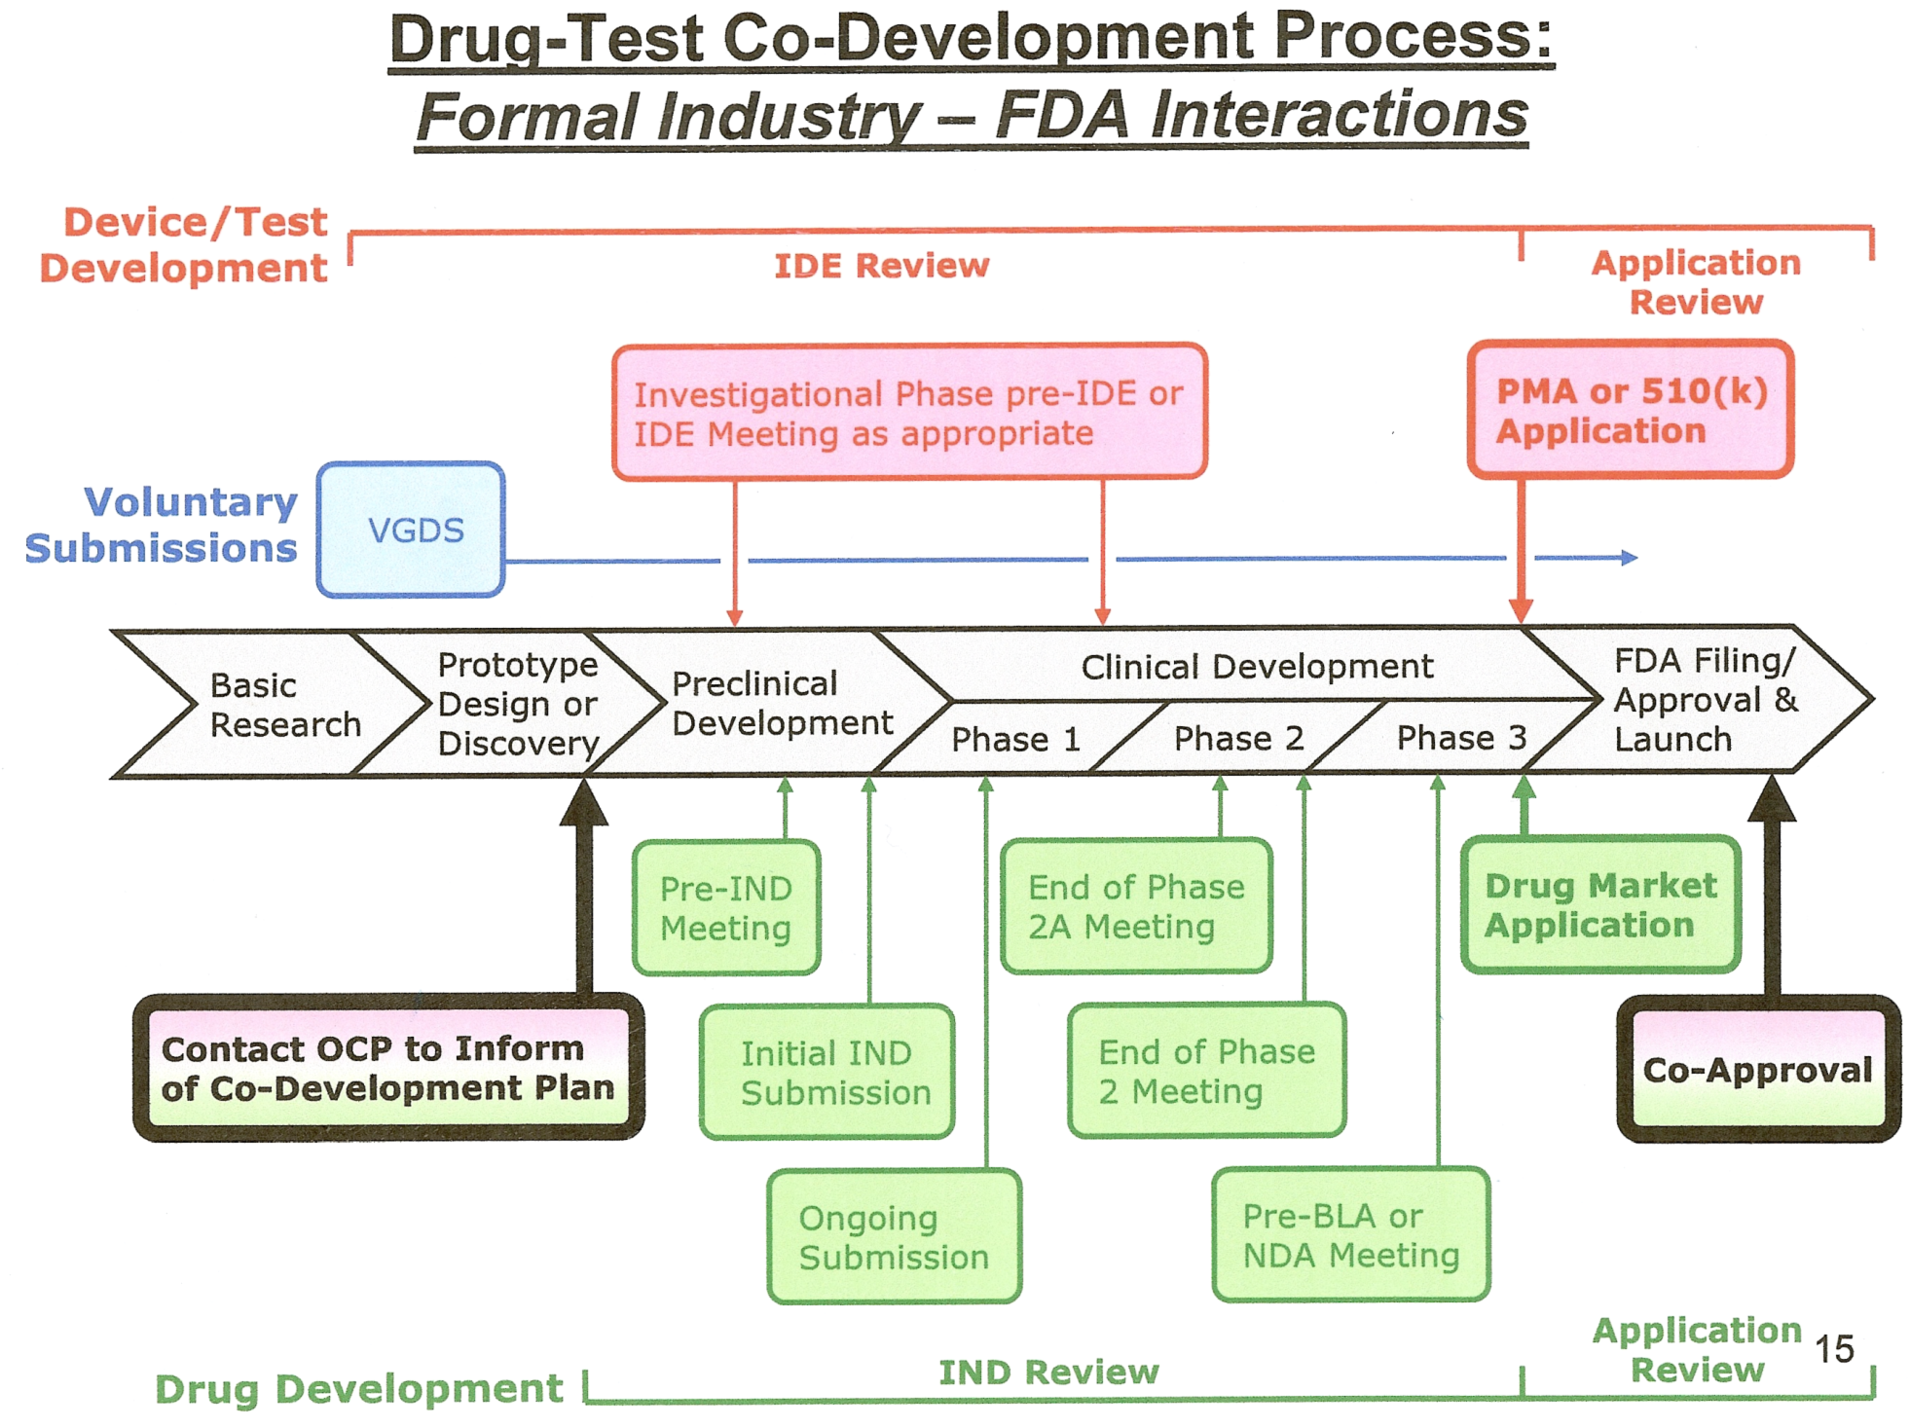
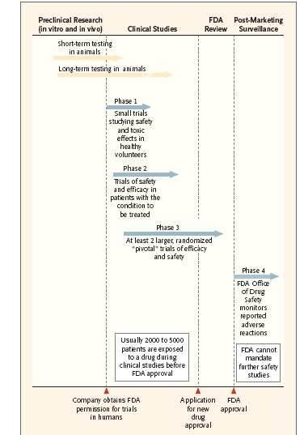

Slide 12
Phases of standard Clinical Trial
Phase I trials focus on safety of a new investigational medicine.
  These are the first human trials after successful animal trials.
Phase II trials are small trials to evaluate efficacy and focus more on a safety profile.
Phase III trials are well-controlled trials, the most rigorous demonstration of a drug’s efficacy prior to federal regulatory approval.
Phase IV trials are often conducted after a medicine is marketed to provide additional details about the medicine’s efficacy and a more complete safety profile.
12

Slide 13
Examples
Physicians Health Study (PHS) (phs.bwh.harvard.edu)
  risks and benefits of aspirin and beta carotene in the prevention of cardiovascular disease and cancer
  started recruitment of US male physicians in 1982
  conducted entirely by mail (much cheaper!!)
  2x2 factorial structure
  Primary endpoint: total mortality
  Secondary endpoint: myocardial infarction
http://phs.bwh.harvard.edu/phs1.htm

Slide 14
Examples
Eastern Cooperative Oncology Group (ECOG)
  Information available at www.ecog.org
  multicenter cancer clinical trial
  Elderly women with stage II breast cancer
  tamoxifen vs placebo
  Double blind study
  primary: tumor recurrence/relapse, disease-free survival
  secondary: total mortality

Slide 15
Basic steps
Protocol
Entrance of patients
Assign of drugs
Carrying out the trial-CRF table
statistical analysis
http://www.dana-farber.org/Health-Library/Entering-a-clinical-trial--Is-it-right-for-you-.aspx
15

Slide 16
Example of Cancer Trial Phase III
What Are Cancer Clinical Trials?
Why Are Cancer Clinical Trials Important?
Type of cancer clinical trials
Phases of cancer Clinical Trial
Statistical principle in clinical trial
  Control /Randomization/Blindness
Statistical analysis
http://www.nhs.uk/video/pages/clinical-trial.aspx
http://www.nhs.uk/conditions/Clinical-trials/Pages/Introduction.aspx
16

Slide 17

What Are Cancer Clinical Trials?
Research studies involving people
Try to answer scientific questions and find better ways to prevent, diagnose, or treat cancer
17
Notes:
Clinical trials are research studies involving people. Clinical trials are the final step in a long research process that includes preliminary laboratory research and animal testing.
Clinical trials try to answer specific scientific questions to find better ways to prevent, detect, or treat diseases, or to improve care for people with diseases.
In cancer research, a clinical trial is designed to show how a certain anticancer approach—for instance, a promising drug, a new surgical procedure, a new diagnostic test, or a possible way to prevent cancer—affects the people who receive it.

Slide 18
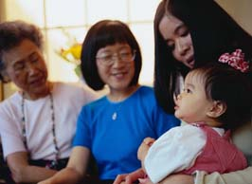
Why Are Cancer Clinical Trials Important?
Clinical trials translate results of basic scientific research into better ways to prevent, diagnose, or treat cancer
Clinical trials in the US have been responsible not only for helping get approval for drugs so that they can be widely used, but in many cases the patients in the trials themselves receive tremendous medical benefit.
The more people that take part, the faster we can:
  Answer critical research questions
  Find better treatments and ways to prevent cancer
18
Notes:
It is important to understand what clinical trials do to fight cancer:
• Clinical trials translate results of basic scientific research into better ways to prevent, diagnose, or treat cancer.
• Clinical trials contribute to knowledge and progress against cancer. Many of today’s most effective cancer treatments are based on previous study results. Because of progress made through clinical trials, many people treated for cancer are now living longer.
• The more people that participate in clinical trials, the faster we can answer the critical research questions that will lead us to better treatment and prevention options for all cancers.

Slide 19
Examples of False Positives
  1.High cholesterol diet and rectal cancer
  2.Smoking and breast cancer
  3.Vasectomy and prostate cancer
  4.Red meat and colon cancer
  5.Red meat and breast cancer
  6.Drinking water frequently and bladder cancer
  7.Not consuming olive oil and breast cancer
  Replication of observational studies may not overcome confounding and bias

Slide 20
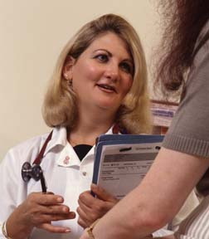
Population & sample in Cancer Clinical Trials?
3 percent of U.S. adults with cancer participate in clinical trials
All of the patients with cancer participate
http://www.nhs.uk/video/pages/clinical-trial.aspx?searchtype=MostViewed&#browse-media-top
20
Notes:
Fewer than 5 percent of U.S. adults with cancer participate in clinical trials—far fewer than the number needed to answer the most pressing cancer questions quickly.
We’ll talk more later about why so few participate.

Slide 21
Types of Cancer Clinical Trials
Treatment trials
Prevention trials(action/agent study, like chemoprevention studies )
Early-detection trials/screening trials
Diagnostic trials
Quality-of-life studies/supportive care studies
21
Notes:
There are at least 5 types of cancer clinical trials:
1. Treatment trials seek to find out:
• What new treatment approaches can help people who have cancer
• What is the most effective treatment for people who have cancer
2. Prevention trials seek to find out what approaches can prevent a specific type of cancer from developing in people who have not previously had cancer
3. Early-detection/screening trials seek to discover new ways of finding cancer in people before they have any cancer symptoms
4. Diagnostic trials seek to find out how new tests or procedures can better identify cancer in people when we think it is there
5. Quality-of-life/supportive care trials seek to find out what kinds of new approaches can improve the comfort and quality of life of people who have cancer

Slide 22
Clinical Trial Phase1
Phase 1 trials
How does the agent affect the human body?
What dosage is safe?
22
Notes:
Clinical trials take place in phases.
Once laboratory studies (in test tubes and animals) show that a new approach has promise, a phase 1 trial can begin. A phase 1 trial is the first step in testing a new cancer agent in humans.
In these studies, researchers look for the best way to give people the new agent (for example, by pill or by injection), how often it should be given, and what the safest dose is. These studies also include special laboratory tests such as blood tests and biopsies to evaluate how the new agent is working in the body.
In phase 1 cancer trials, small groups of people with cancer are treated with a certain dose of a new agent that has already been extensively studied in the laboratory. The dose is usually increased group by group in order to find the highest dose that does not cause harmful side effects. This process determines a safe and appropriate dose to use in a phase 2 trial.
While the primary purpose of phase 1 trials is to find the safest dose of a new agent, researchers also evaluate whether the new agent benefits patients.
People with cancer who are eligible for phase 1 studies have no known effective treatment options, or they have already tried other treatment options. Many participate in these trials because they want to help others and contribute to cancer research. Phase 1 cancer trials usually have 15 to 30 participants.

Slide 23
Clinical Trial Phases2
Phase 2 trials
Does the agent or intervention have an effect on the cancer?
23
Notes:
Clinical trials take place in phases.
Once laboratory studies (in test tubes and animals) show that a new approach has promise, a phase 1 trial can begin. A phase 1 trial is the first step in testing a new cancer agent in humans.
In these studies, researchers look for the best way to give people the new agent (for example, by pill or by injection), how often it should be given, and what the safest dose is. These studies also include special laboratory tests such as blood tests and biopsies to evaluate how the new agent is working in the body.
In phase 1 cancer trials, small groups of people with cancer are treated with a certain dose of a new agent that has already been extensively studied in the laboratory. The dose is usually increased group by group in order to find the highest dose that does not cause harmful side effects. This process determines a safe and appropriate dose to use in a phase 2 trial.
While the primary purpose of phase 1 trials is to find the safest dose of a new agent, researchers also evaluate whether the new agent benefits patients.
People with cancer who are eligible for phase 1 studies have no known effective treatment options, or they have already tried other treatment options. Many participate in these trials because they want to help others and contribute to cancer research. Phase 1 cancer trials usually have 15 to 30 participants.

Slide 24
Clinical Trial Phase3
Phase 3 trials
Is the new agent or intervention (or new use of a treatment) better than the standard?
Participants have an equal chance to be assigned to one of two or more groups
24
Notes:
Phase 3 trials focus on learning how a new treatment compares to “standard treatment” (the most widely accepted treatment, based on results of past research). Researchers want to learn whether the new treatment is better than, the same as, or worse than the standard treatment.
In most cases, trials move into phase 3 testing only after a treatment shows positive results in phase 2 trials.
In phase 3 trials, participants have an equal chance of being assigned to one of two or more groups (also called “arms”).
The process of assigning participants to groups is called randomization.
Many people with cancer choose to get their first treatment in a phase 3 cancer trial. The type of participant varies, depending on the kind of question being asked about a particular cancer. Phase 3 trials usually have hundreds to thousands of participants, in order to find out if true differences exist in the effectiveness of the treatments being tested.

Slide 25
Statistical consideration for RCT
Control group
  Use of proper control group necessary due to:
    Natural history of most diseases
    Variability of a patient's response to intervention
Randomization
Blindness

Slide 26
Randomized Trials
Participants have an equal chance to be assigned to one of two or more groups:
  One gets the most widely accepted treatment (standard treatment or placebo)
  The other gets the new treatment being tested, which researchers hope and have reason to believe will be better than standard treatment
26
Notes:
Phase 3 trials are randomized clinical trials, and some phase 2 trials may also be randomized.
Randomization is a method used to prevent bias in research. Treatment assignments are generated by a computer, and each participant hae an equal chance of being assigned to one of two or more groups, the control group and the treatment group:
The control group is made up of the people who get the most widely accepted treatment (standard treatment) for their cancer
The investigational group is made up of the people who get the new treatment being tested.
The next slide illustrates how randomization works.

Slide 27
Control group
To compare for identify the difference treatment validated effective
Placebo group

Slide 28
Placebo
Placebos are almost never used:
Placebos are used only when no standard treatment exists
Patients are told of this possibility before deciding to take part
Sometime used in prevention trial.
http://www.nhs.uk/video/pages/Placeboeffect.aspx?
searchtype=Search&searchterm=clinical+trial+&offset=1&
28
Notes:
Placebos (treatments, often drugs, designed to look like the medicine being tested but that don’t contain any active ingredient) are almost never used in cancer treatment trials.
Placebos are used in treatment trials only when we don’t yet have a known approach (standard agent) for a particular type of cancer.
Patients are told if this is a possibility before they decide whether to take part.

Slide 29
Random Allocation
The laboratory investigator uses animals in projects, but the animals are not selected randomly from a large population of animals.
The clinician, who is attempting to describe the results obtained with a particular therapy, cannot say that he or she has obtained patients as a random sample from a parent population of patients.
Randomization is only used in allocating testee to diff. Treatment groups.
Random Allocation rather than random sampling
29

Slide 30
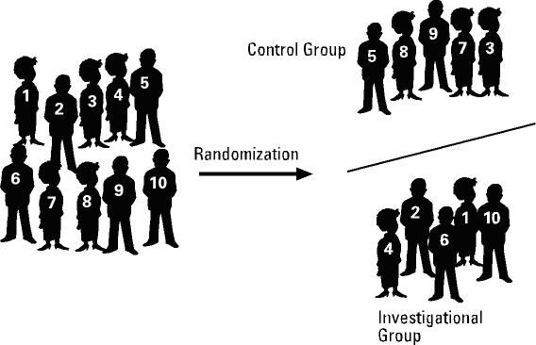
Randomization
30
Notes:
Explain slide

Slide 31
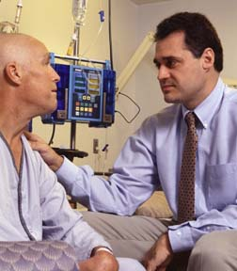
Why Is Randomization Important?
So all groups are as alike as possible
Provides the best way to prove the effectiveness of a new agent or intervention
31
Notes:
If participants or doctors choose a particular group based on what they think is best, then one of the groups would likely be very different than the other, making comparison between the groups difficult.
Randomization eliminates this bias because participants have an equal chance of being assigned to either group and the subgroups are as similar as possible.
Comparing similar groups of people taking different treatments for the same type of cancer is a way to ensure that the study results are caused by the treatments rather than by chance or other factors.

Slide 32
Clinical Trial Protocol
A recipe or blueprint
Strict scientific guidelines:
  Purpose of study
  How many people will participate (sample size determination)
  Who is eligible to participate
  How the study will be carried out
  What information will be gathered about participants
  Endpoints
32
Notes:
Clinical trials follow strict scientific guidelines. These guidelines clearly state the study’s design and who will be able to participate in the study.
Every trial has a head person in charge, usually a doctor, who is called the principal investigator. The principal investigator prepares a plan for the study, called a protocol, which acts like a “recipe” for conducting a clinical trial.
The protocol explains what the trial will do, how the study will be carried out, and why each part of the study is necessary.
Every doctor or research center that takes part in the trial uses the same protocol. This ensures that participants are treated identically no matter where they are receiving treatment, and that information from all the participating sites can be combined and compared.

Slide 33
Blindness or masking
To avoid the possibility of assessment bias
Single blind/double blind
  The assessor and subjects don’t know which treatment the subject is receiving.
Notes:
The assessment by the researcher of response to treatment may be influenced b the knowledage of the treatment, or expection, desire that the treatment should be succeed. If just subjects do not the assignment of treatment;
If both subjects and researcher or experimenter do not the assignment of treatments

Slide 34
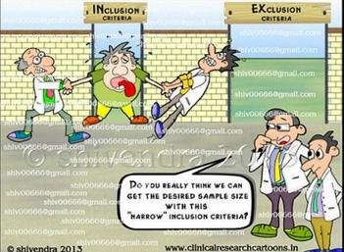
Inclusion and exclusion
Who should enter the study?
Who will drop out of the study?

Slide 35
Informed Consent
Learning the key facts about a trial before deciding whether to participate.
  Research study purpose
  Risks/Benefits
  Alternative treatments
  Confidentiality of records
  Medical treatment available if injury occurs
  Whom to contact for answers to questions
  Statement that participation is voluntary

Slide 36
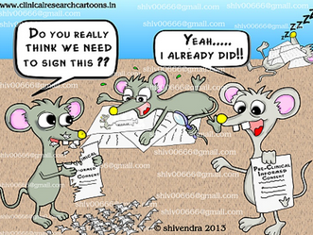
Informed consent form (ICF)
http://oprs.usc.edu/files/2013/04/Informed-Consent-Booklet-4.4.13.pdf

Slide 37
Institutional Review Board
(IRB)
All clinical trials must be approved and monitored by an IRB.
IRB is an independent committee of physicians, nurses, statisticians, community advocates and others.
The function of the IRB is to ensure that a clinical trial is ethical and the rights welfare of study participants are protected.

Slide 38
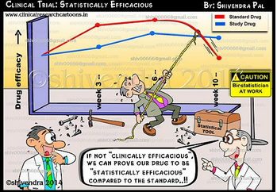
Statistical Analysis
  What information will be gathered about participants
  Endpoints
What methods will be employed?
That depends on the types of data
38

Slide 39
Case report form(CRF)
A case report form (or CRF) is a paper or electronic questionnaire specifically used in clinical trial research. The Case Report Form is the tool used by the sponsor of the clinical trial to collect data from each participating site.

Slide 40
Survey
Population and sample (review)
Sampling frame
  to sure the samples representative for population
Sampling technique
Design of questionnaire

Slide 41
Basics to Survey
sampling framework
Sampling error and non-sampling error
Sampling technique

Slide 42
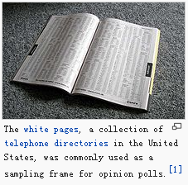
Sampling frame
In statistics, a sampling frame is the source material or device from which a sample is drawn.[2] It is a list of all those within a population who can be sampled, and may include individuals, households or institutions.[2]

Slide 43
Type of sampling frame
The most straightforward type of frame is a list of elements of the population (preferably the entire population) with appropriate contact information.
some list only 'clusters'. For example, a street map can be used as a frame for a door-to-door survey;

Slide 44
Non Sampling error
Problem of frame may be sampling bias caused by wrong defining of sampling frame
sampling bias is a bias in which a sample is collected in such a way that some members of the intended population are less likely to be included than others. It results in a biased sample, a non-random sample of a population (or non-human factors) in which all individuals, or instances, were not equally likely to have been selected.

Slide 45
Sampling Techniques
Simple random sample
Stratified sample
Cluster sample
Systematic sample
Convenience sample
45

Slide 46
Simple Random Sample
A simple sample is one in which every member of the population has an equal chance of being selected.
So it is a basic sample technique.
46

Slide 47
Example of SRS
There are 731 students enrolled in statistics in our school.
I wish to form a sample of 8 students to answer some questions.
Population-731 students
Sample -8 students
47

Slide 48
APPENDIX A: TABLE OF RANDOM NUMBERS
63271 59986 71744 51102 15141 80714 58683 93108 13554 79945
88547 09896 95436 79115 08303 01041 20030 63754 08459 28364
55957 57243 83865 09911 19761 66535 40102 26646 60147 15704
46276 87453 44790 67122 45573 84358 21625 16999 13385 22782
55363 07449 34835 15290 76616 67191 12777 21861 68689 03263
69393 92785 49902 58447 42048 30378 87618 26933 40640 16281
13186 29431 88190 04588 38733 81290 89541 70290 40113 08243
17726 28652 56836 78351 47327 18518 92222 55201 27340 10493
36520 64465 05550 30157 82242 29520 69753 72602 23756 54935
81628 36100 39254 56835 37636 02421 98063 89641 64953 99337
84649 48968 75215 75498 49539 74240 03466 49292 36401 45525
63291 11618 12613 75055 43915 26488 41116 64531 56827 30825
70502 53225 03655 05915 37140 57051 48393 91322 25653 06543
06426 24771 59935 49801 11082 66762 94477 02494 88215 27191
20711 55609 29430 70165 45406 78484 31639 52009 18873 96927
41990 70538 77191 25860 55204 73417 83920 69468 74972 38712
72452 36618 76298 26678 89334 33938 95567 29380 75906 91807
37042 40318 57099 10528 09925 89773 41335 96244 29002 46453
53766 52875 15987 46962 67342 77592 57651 95508 80033 69828
90585 58955 53122 16025 84299 53310 67380 84249 25348 04332
32001 96293 37203 64516 51530 37069 40261 61374 05815 06714
48

Slide 49
Procedure
1 assign numbers 1 to 731 to each students in this course
Choose a starting place at random and read the digits in the first column in groups of 3.
The students who were assigned these number will make up the sample
572|43 8|386|5 09|911| 197|61 6|653|5 40|102| 266|46 6|014|7 15|704
49

Slide 50
Stratified Sample
When it is important for the sample to have members from each segment of the population, you should use it.
the member of population are divided into 2 or more different subsets, called strata.
Each segment of population is represented.
50

Slide 51
Example of Household Survey
individuals from 3 Socioeconomic Levels make up sample.
Strata1: middle income
Strata1: low income
Strata1: high income
51

Slide 52
Cluster Sample
the polulation falls into naturally occurring subgroups,for example, classes in school or branches of bank
Divide the population into groups, called clusters.
Choose one or more cluster, the members in the selected clusters make up sample.
Care must be taken to ensure that all clusters have similar characterisics.
52

Slide 53
Systematic Sample
Assign a number to each member of the population
Select randomly a starting number, then sample members are selected at regular intervals from the starting number, for instance, every 3rd,5th, or 100th member is selected.
53

Slide 54
Convenience Sample
A Convenience sample consists only of available sample.
Not a representative sample.
54

Slide 55
Sample size estimation
Sample size should be determined on design
Sample size is estimated based on the different study parameters.
Statistical software has been developed
From typical statistical software like SAS,
Specific for sample size like PASS.

Slide 56
Design of questionnaire
https://www.surveymonkey.com/mp/sample-survey-questionnaire-templates/

Slide 57
Thank you for your attention!

