Slide 1
Descriptive statistics (2)
Qualitative data

Slide 2
Another Classification
numerical variable
categorical variable
binary variable/ dichotomous
polytomous variable
multinomial
Ordinal (or ranked data)

Slide 3
Descriptive statistics for categorical data
Relative number and application
tabular and graphic methods

Slide 4
numerical method -Relative number
Rate
Proportion
Ratio

Slide 5
Rate
In contrast to the static nature of proportions, rates are aimed at measuring the occurrences of events during or after a certain time period.
(1) Changes
(2) Measures of Morbidity and Mortality

Slide 6
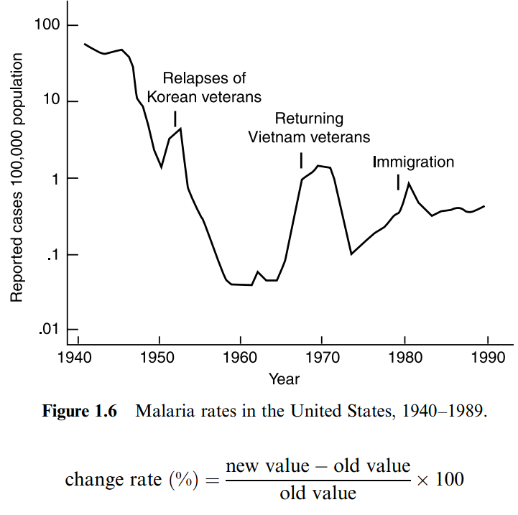
Change rate

Slide 7
Rate-Force Index
A single figure that measures the forces of specific events, for example death, disease. mortality & morbidity)
a= the frequency with which an event has occurred during some specified period of time.
a+b= the number of person exposed to the risk of the event during the same period of time
K=some number such as 100,1000,100,000

Slide 8
Vital Statistics-Rates as measure of health status.
Incidence rate (morbidity)
prevalence rate

Slide 9
Measures of Morbidity and Mortality
Unlike change rates, these measures are proportions.
3 types of rate are commonly mentioned:
crude, specific, & adjusted (or standardized)
Crude rates are computed for an entire large
group or population; they disregard factors
such as age, gender, and race.
Adjusted or standardized rates are used to make
valid summary comparisons between 2 or more
groups possessing different age distributions.

Slide 10
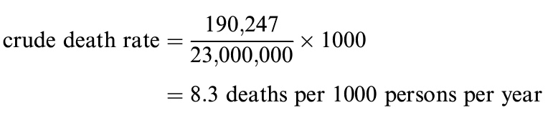
The annual crude death rate is defined as the number of deaths in a calendar year divided by the population on July 1 of that year .
the 1980 population of California
was 23,000,000(as estimated by July 1) and
there were 190,237 deaths during 1980.
Age-specific death rate

Slide 11
Proportion
Composing index, The relative frequency of every composition taking account of special factor, such as race, sex, age group in a whole group.
For example, sex proportion, race proportion, age proportion.

Slide 12
Homogenous in factors except for treatment
Comparison of morbidity between two region.
Sex, age distribution should be equal significantly.
For the sex, age may be the factor that effect the mortality.

Slide 13
Rate & proportion
The term rate is somewhat confusing; sometimes it is use d interchangeably with the term p oportion; sometimes it refers to a quantity of a very different nature.
Sometimes, we focus on rates used interchangeably with proportions as measures of morbidity and mortality.
Even when they refer to th e same things — measures of morbidity and mortality —there is some degree of difference between these two terms. In contrast to the static nature of proportions, rates are aimed at measuring the occurrences of events during or after a certain time period .

Slide 14
Ratio-comparison index
C,d the frequency or relative frequency of occurrence of some events or terms,such as the person-doctor ratio,the person-hospital bed ratio.
K used in ratio are mostly 1 and 100.

Slide 15
Sex ratio in China in 2000
＝(65355units/64228 units)X100=106.74
1 unit=10,000 万 (wan)

Slide 16
Summary of relative number
BMI group | number | N of patients | ratio | Composition % | prevalence rate %
（1） | （2） | （3） | （4） | （5） | （6）
low | 212 | 10 | — | 3.10 | 4.72
Overweight | 661 | 57 | 5.70 | 17.65 | 8.62
light obesity | 1120 | 125 | 12.50 | 38.70 | 11.16
Middle obesity | 825 | 112 | 11.20 | 34.67 | 13.58
Heavy obesity | 102 | 19 | 1.90 | 5.88 | 18.63
total | 2920 | 323 | — | 100.00 | 11.06
BMI (body mass index)

Slide 17

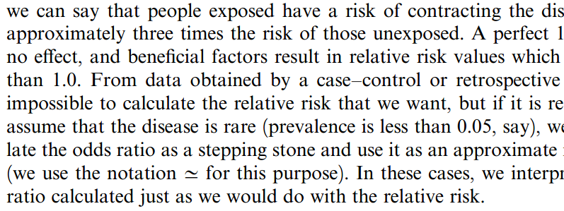

Slide 18
Note on calculation of relative number
The denominator should not be two small
½=50%???
The average relative frequencies can not be added directly when n’s are not the same.
Difference between force index & composition index
 | disease | No disease | total | rate
male | 20 | 20 | 40 | 0.5
female | 45 | 15 | 60 | 0.75
total | 65 | 35 | 100 | 0.65

Slide 19
Construction of statistical table
A table is intended to communicate information, so it should be easy to read and understand.
A statistical table has at least four major parts and some other minor parts.
(1) The Title, (2) The Box Head (column captions),(3) The Stub (row captions), (4) The Body, (5) Notes.

Slide 20
Frequency table for categorical data

Slide 21
structure of Statistical table
(1) The Title: must explain the contents of the table.
(2) Column captions
(3) Row captions
(4) The Body:
It is the main part of the table which contains the numerical information.

Slide 22
Displaying data graphically
One of the first things that you may wish to do when you have entered your data onto a computer is to summarize them in some way so that you can get a 'feel' for the data.
diagrams, tables or summary statistics.
Diagrams are often powerful tools for conveying information about the data, for providing simple summary pictures

Slide 23
Bar Chart
A bar chart shows data in the form of horizontal or vertical bars.
Figure2.4 shows cancer of the oesophagus in the form of a bar chart, the heights of the bars being proportional to the mortality.
The bars are separated by small gaps to indicate that the data are categorical or discrete.

Slide 24
Simple Bar Chart
A simple bar diagram is used to represent only one variable.
Bar chart can be used to show the relationship
between two variables, one being quantitative
and the other either qualitative or a quantitative
variable which is grouped, as is time in years.
Table2.10 Cancer of the oesophagus: standardized mortality rate per
100,000 per year, England and Wales, 1960-1969

Slide 25
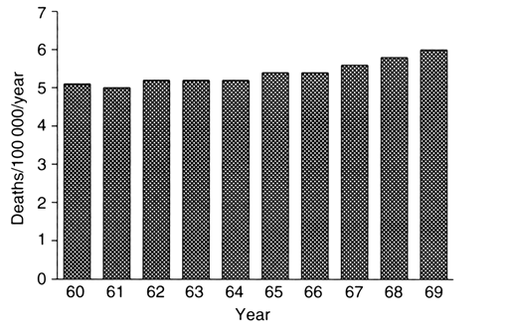
Figure 2.4 Bar chart showing the relationship between mortality
due to cancer of the oesophagus and year, England and Wales, 1960-1969

Slide 26
Multiple bar
Multiple bar charts can be used to represent relationships between more than 2 variables.
the relationship between children's reports of breathlessness and cigarette smoking by themselves and their parents.

Slide 28
Bar chart for quantitative data

Slide 29
Pie chart
The pie chart or pie diagram, shows the relative frequency for each category by dividing a circle into sections, one for each category, so that the area of each section is proportional to the frequency in that category. And the angles of which are proportional to the relative frequency also.

Slide 32
Line Graphs
A line graph is similar to a bar chart, but the horizontal axis represents time.
Different ‘‘groups’’ are consecutive years, so that a line graph is suitable to illustrate how certain proportions change over time.
In a line graph, the proportion associated with each year is represented by a point at the appropriate height; the points are then connected by straight lines.

Slide 33
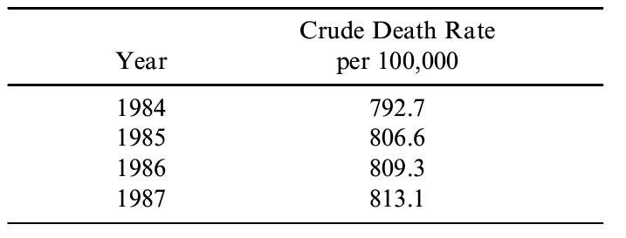
Table 2.13 crude death rates for women between the years 1984 and 1987

Slide 34
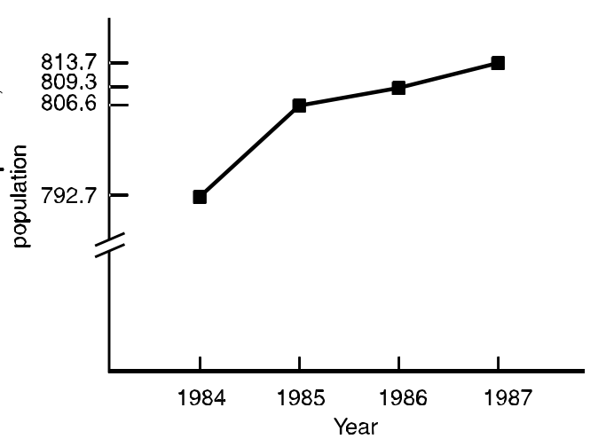
Figure 3.9 Death rates for U.S.women,1984–1987

Slide 35
Line for quantitative data

Slide 36
Scatter diagrams
The bar chart shows the relationship between two continuous variables
such as vital capacity(Y) and weight(X) for 12 female students.

Slide 37
Table3.10 The relation of vital capacity and weight for 12 female students

Slide 38
Standardization rate
Why?
How?
  Direct method
  Indirect method
properties
38

Slide 39
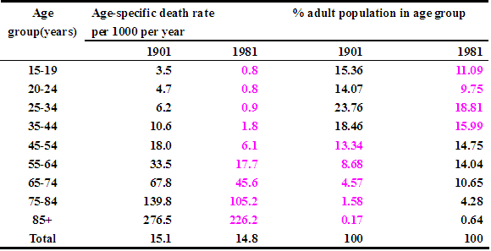
Why standardized rate?
Why? There are different age structures in the populations in 1901 and 1981 .
39

Slide 40
Direct methods
To eliminate this impact from different age proportion ,we can use standardization methods
Direct methods
  select a standard population structure to calculate a adjusted rate.
  a standard population with specific age proportion must be great in size, steady, and representative.

Slide 41
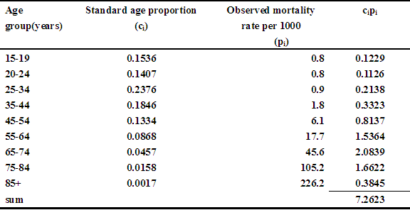
Direct method for 1981
The age-standardized mortality rate for 1981 was 7.3 per 1000 men per year.There was much higher in 1901 than in 1981.
41

Slide 42
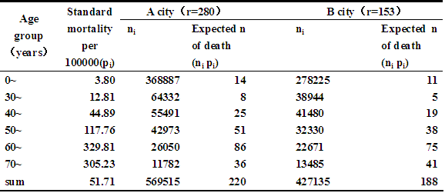
Indirect method
42
Notes:
If the observed age specific mortality is estimated poorly,or we have no observed age specific mortality we use indirect methods.

Slide 44

Thanks

